Slide 1
Welcome, “Virtually” to
Johnson C. Smith University
In Partnership with
FaithHealthNorth Carolina: A Shared Mission of Healing
John W. Hatch Lecture Series
Tuesday, November 30, 2021
Division of Student Affairs
Presented by: Davida L. Haywood, PhD
Vice President

Slide 2
Johnson C. Smith University
Institutional Vision
Our institutional vision is to prioritize academic excellence and be recognized as a premier professional liberal arts HBCU, providing students with high-quality academic, social, personal, professional and spiritual learning experiences that lead to individual growth and development, a strong sense of community and purpose and top career outcomes.
Primary Sources: Johnson C. Smith University Website and Charlotte's Historic West End Website

Slide 3
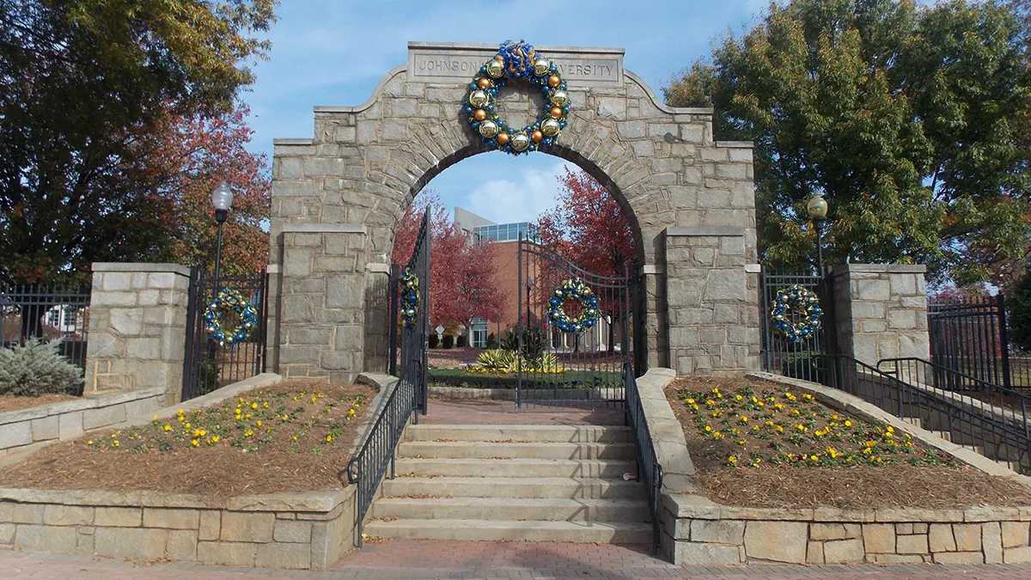
Johnson C. Smith University
You Are Always Welcome to Pass Through Our Memorial Arch Gates!
Primary Sources: Johnson C. Smith University Website and the Digital NC Website

Slide 4
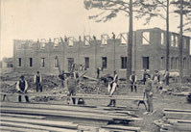
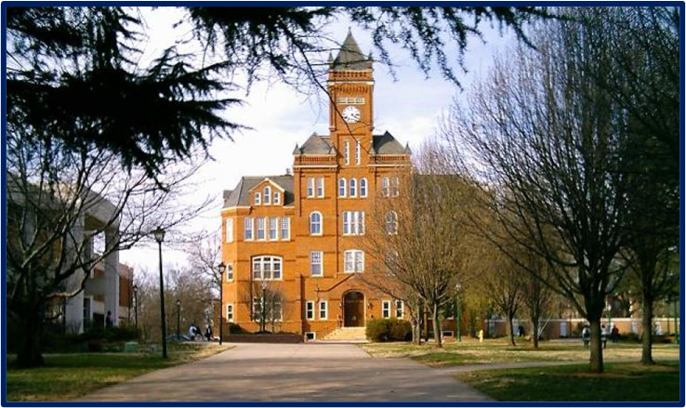
Johnson C. Smith University
The Commencement of Educating Students’ “Whole Self:” Minds, Bodies and Spirits
In 1883, students who learned during the day, erected Biddle Memorial Hall at night—brick by brick.
Today, this building still stands as the university’s main administration building (along with its 600-seat auditorium).
Primary Sources: Johnson C. Smith University Website and the Digital NC Website

Slide 5
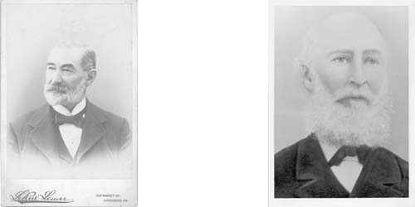
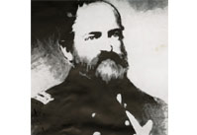
Johnson C. Smith University
The Importance of Faith in the Evolution of Johnson C. Smith University
JCSU was founded in 1867, as the Freedman’s College of North Carolina, under the auspices of Reverends S. C. Alexander and W. L. Miller.
From 1867-1876, the university was renamed Biddle Memorial Institute, in honor of Major Henry Biddle, by way of a $1,400 donation from Mary D. Biddle.
Primary Sources: Johnson C. Smith University Website and the Digital NC Website

Slide 6
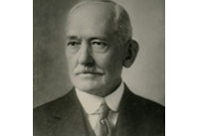
Johnson C. Smith University
1900s-1940s: The Educational Home of “Preachers and Teachers”
In 1921, the late Jane Berry Smith gave funds to build a theological dormitory, science hall, teacher’s cottage and memorial gate; and, an endowment in memory of her late husband, Johnson C. Smith University—for which the college was renamed.
Primary Sources: Johnson C. Smith University Website and the Digital NC Website

Slide 7
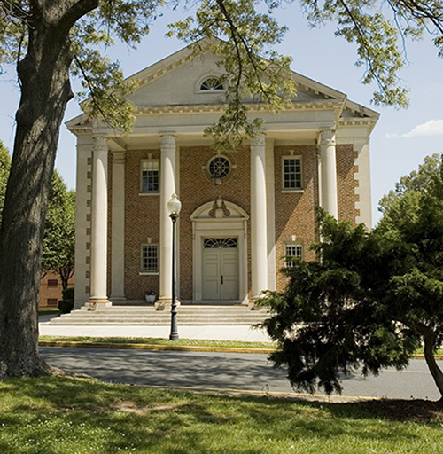
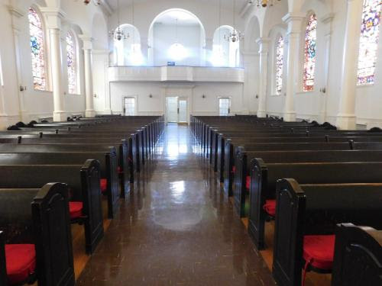
Johnson C. Smith University
Jane M. Smith Church: Where Spiritual Life Thrives!
Primary Sources: Johnson C. Smith University Website and the Digital NC Website

Slide 8
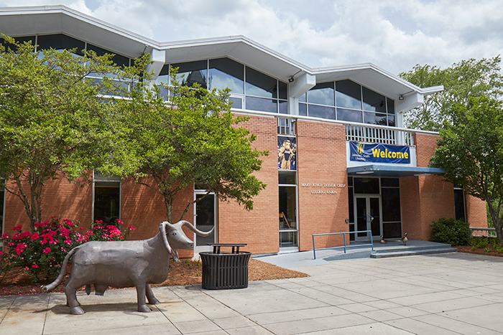
Johnson C. Smith University
Mary J. Crisp Memorial Student Union and “The Block”: Where Students Gather!
Primary Sources: Johnson C. Smith University Website and Charlotte's Historic West End Website

Slide 9
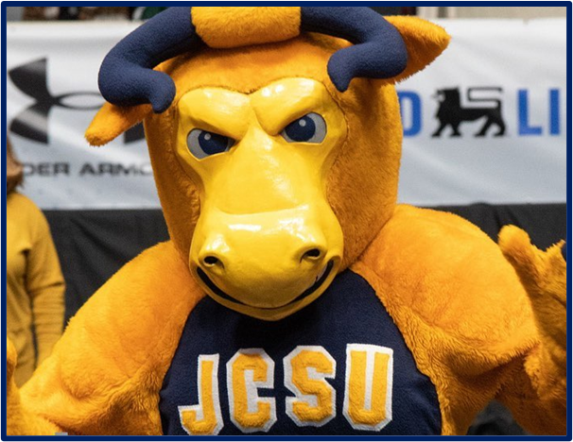
Johnson C. Smith University
Welcome From Johnson C. Smith University!
Primary Sources: Johnson C. Smith University Website and Charlotte's Historic West End Website

