Slide 1
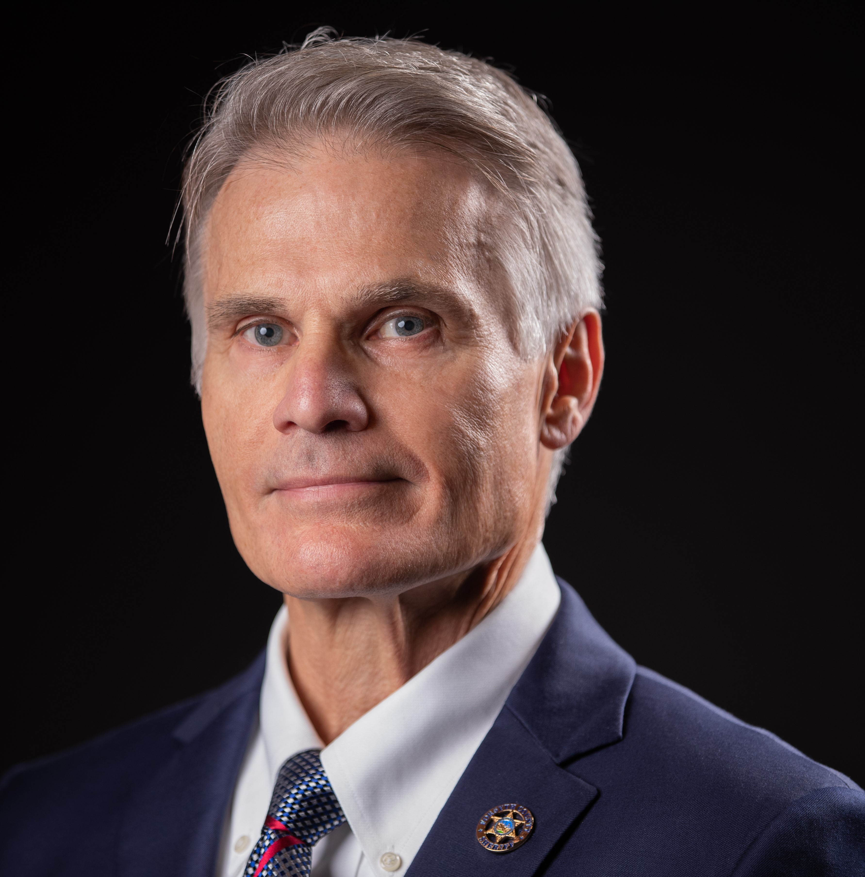
DIVISION of FAITHHEALTH GRAND ROUNDS
“Overview of the First Responder Chaplaincy Program”
Glenn Davis, MDiv
Director, First Responder Chaplaincy Program
Atrium Health Wake Forest Baptist
January 26, 2022
9:00 a.m. to 10 a.m.
Text: 336-793-9317; Code: 073AA
Join Zoom Meeting
https://us02web.zoom.us/j/85769101353?pwd=cHU0MkxqOUphTURFWXNaWFZVdVNnZz09
Meeting ID: 857 6910 1353
Passcode: 083148
One tap mobile
+13017158592,,85769101353#,,,,*083148# US (Washington DC) or +13126266799,,85769101353#,,,,*083148# US (Chicago); Dial by your location: +1 301 715 8592 US (Washington DC) ; +Meeting ID: 857 6910 1353Passcode: 083148 Find your local number: https://us02web.zoom.us/u/kuHH7cPZa
Accreditation: The Wake Forest School of Medicine is accredited by the Accreditation Council for Continuing Medical Education to provide continuing medical education for physicians.
Credit: The Wake Forest School of Medicine designates this live activity for a maximum of 1.0 AMA PRA Category 1 Credit(s)TM. Physicians should claim only the credit commensurate with the extent of their participation in the activity.
Objectives: At the conclusion of this CME activity, the learner should be better able to::
Summarize the basic purpose/content of the book and of First Responder Chaplaincy (FRC) work.
Name at least 3 "lessons learned" from case studies presented in the book.
Develop a better understanding not just of FRC but also a better understanding and appreciation for ALL of our First Responders and their families.
Planning Committee: No member of the Planning Committee or staff has anything relative to this activity to disclose; Speaker/Presenter/Teacher: Glenn Davis has nothing to disclose in regard to today’s activity.

